Slide 1
Date for your diary: Nov 1
The next tech session, on audio recording, will take place on Nov 1 after our class (12-2) in C265

Slide 2
A reminder of the directed study
Brainstorm ideas for an interview-based story using the techniques you read about. Choose 3 of the best ideas and develop (improve) them
Write about the process and what you’ve learned (evaluate) — share with paul.bradshaw@bcu.ac.uk
Pick one idea and identify 5 people you could interview
Conduct background research on your story idea - summarise it in a one page briefing (with links) sent to me!

Slide 3
Review:
Any questions from the reading?
Reflection on idea generation? Experiments with genAI?
Background story research - share your summary
Which 5 people did you list to interview?
If you didn’t do it — why? Identify the barriers and tackle them

Slide 4

Story-led research
Paul Bradshaw | MED7334 Narrative

Slide 5
By the end of this week you should
Be able to use a story idea to lead you to diverse and useful sources and interviewees
Be able to identify and avoid common mistakes
And improve the chances of sources speaking to you

Slide 6
Sources

Slide 7
Human vs documentary sources
Human sources: original information and media which makes your story unique. May be exclusive. Aka ‘primary sources’
Documentary sources: open data and research, media footage, coverage and statements, typically public. Tends to flesh out and connect the unique material into a story. Aka ‘secondary sources’.
If you get exclusive docs/data/media then that might make the story unique, and the roles reversed (human sources flesh out + connect)

Slide 8
_Triangulating sources_
People
Can lead to
Can lead to
Docs
Data
Documents
Data
Can lead to
Reference: Bradshaw, Paul (2023) The Online Journalism Handbook, Routledge

Slide 9
Commonly used documentary sources
‘Cuttings search’: Nexis, Google News
Data: official and unofficial: trends, key categories/places
Reports/briefings: Problems, proposals, trends
Research: what questions are being asked, by who?
Company accounts: is business better or worse? What are the problems? Who owns the businesses?

Slide 10
Useful resources
Google Scholar, Academia.edu, Core.ac.uk - search research
Unpaywall.org: scholarly articles and extension
Industry bodies, select committees, Parliament briefings
Charities, unions
Gov.uk research and statistics; ONS; HESA; Data.Police.uk
Companies House; Charity Commission

Slide 11
Do it now:
You have been tasked with doing a story about graffiti
Group 1: Do a cuttings search using Nexis. What stories have already been done? Who appears in those?
Group 2: Look for reports and research on the topic. What key points are they making? Who is writing it?

Slide 12
Human sources can be…
Interviewee: whose knowledge/experiences form part of a story
‘On background’: helps you to understand the topic you are telling a story about, even if they’re not in it
Go-between: directs you to other people and information

Slide 13
Interviewees

Slide 14
Why do we need (good) interviewees?
Why don’t we just Google the information we need?
Notes:
Originality; engagement (variety, conflict, visuals); verification; SMO

Slide 15
Do it now (5 minutes):
Generate ideas for interviewees for
A story about graffiti

Slide 16
What makes a good interviewee?
What interviewees make for good stories?

Slide 17
What makes a good interviewee? PEER!
Power (political, financial, cultural, legal)
Expertise
Experience (first-hand or witness)
Representative (represents a group of people)
…plus clarity and engagement

Slide 18
Examples:
Power: politician/CEO/celeb/police
Expertise: academic/researcher/successful
Experience: case study/witness
Representative: union/campaign/charity representative

Slide 19
Different types of source_+ potential story roles_
Role | Power | Expert | Representative | Witness | Case study
Action | Takes action/ Proposes or announces plans for action. Objects to plans/actions. | Publishes research Raises concerns | Raises concerns, calls for action | Provides new information about an event | Takes legal action or campaigns
Context/ colour | Explains reasons for decision or action | Provides background to an issue, event or claim | Describes how members are affected | Describes what they saw/ heard happen | Describes what happened to them, and the effects
Reaction | Criticises or supports action or proposals | Criticises or supports action or proposals | Criticises or supports action or proposals |  | Criticises or supports action or proposals
Reply | To criticism of, or concerns about, their actions |  | To criticism of, or concerns about, the actions of members
Reference: Bradshaw, Paul (2024) The Online Journalism Handbook

Slide 20
The best £20 you’ll ever spend: 16 affordable essentials the experts swear by
“First, I had to identify the experts. When it came to fashion, I immediately thought of Chioma Nnadi, British Vogue’s head of editorial content, who has impeccable taste. My pet-related expert had to be the dog behaviourist Louise Glazebrook. Her book, The Book Your Dog Wishes You Would Read, was a lifeline when I got my puppy.
“Kelly Holmes was another obvious choice. The double Olympic champion has recently turned her attention to home fitness – including for beginners – so I knew she would be able to advise on work-out equipment for the exercise-averse.

Slide 21
Pat McGrath, makeup artist and founder of Pat McGrath Labs
Ana Kirova, CEO of the dating app Feeld
Benjamina Ebuehi, former Great British Bake-Off contestant and author of three cookbooks, including I’ll Bring Dessert
Laura Mountford, cleaning expert and author of Live, Laugh, Laundry: A Calming Guide to Keeping Your Clothes Clean – and You Happy
Nick Littlehales, sport sleep coach and author of Sleep
Charlie Casely-Hayford, menswear designer

Slide 22
Do it now (10 minutes):
Look at your ideas for interviewees and identify any gaps:
What types of experts could you add?
What sorts of case studies could you include?
Who holds positions of power in this field?
What groups does the story touch on, and who might represent them?

Slide 23
Reference this in the assignment
How did you generate ideas for interviewees, with reference to your reading, e.g.
I used Bradshaw’s framework (Bradshaw 2024) to generate a wide range of ideas for interviewees.

Slide 24
Evidence this in the assignment
Document your brainstorming and include that in an appendix, e.g.
I used Bradshaw’s framework (Bradshaw 2024) to generate a wide range of ideas for interviewees (Appendix B).

Slide 25
Problems

Slide 26
Here are your typical problems:
We struggle to find interviewees
We struggle to get an interview
The interview doesn’t give us what we need

Slide 27
Checklist: common mistakes
Picking the first name you find (not the best)
Picking the easiest source (e.g. one you already know)
Using social media only (the people who shout loudest)
Failing to follow up (people expect it)
Unprofessional/demanding approaches (it’s their time)
Being too literal (look beyond the obvious interviewees)
Not having a Plan B (what if it falls through?)

Slide 28
“85% of women on the internet* have been exposed to online violence.
So it’s no surprise that women participate less; with a 10-point gap between the percentage of men and women online — signalling a “digital gender divide”.”
(Narayanan 2024)

Slide 29
Where to find experts to interview
University experts’ directories
Google Scholar, Academia.edu: who’s researching it?
Reports and books about the subject: who wrote them?
Cuttings: who’s been quoted before?
Awards: who’s won them?
Eventbrite: who’s been invited to speak?
LinkedIn: who works in the field?

Slide 30
Where to find case studies
Specialist forums/Facebook groups etc.
Go-betweens: charities
Campaign groups and unions
Facebook group owners
People who interviewed them before

Slide 31
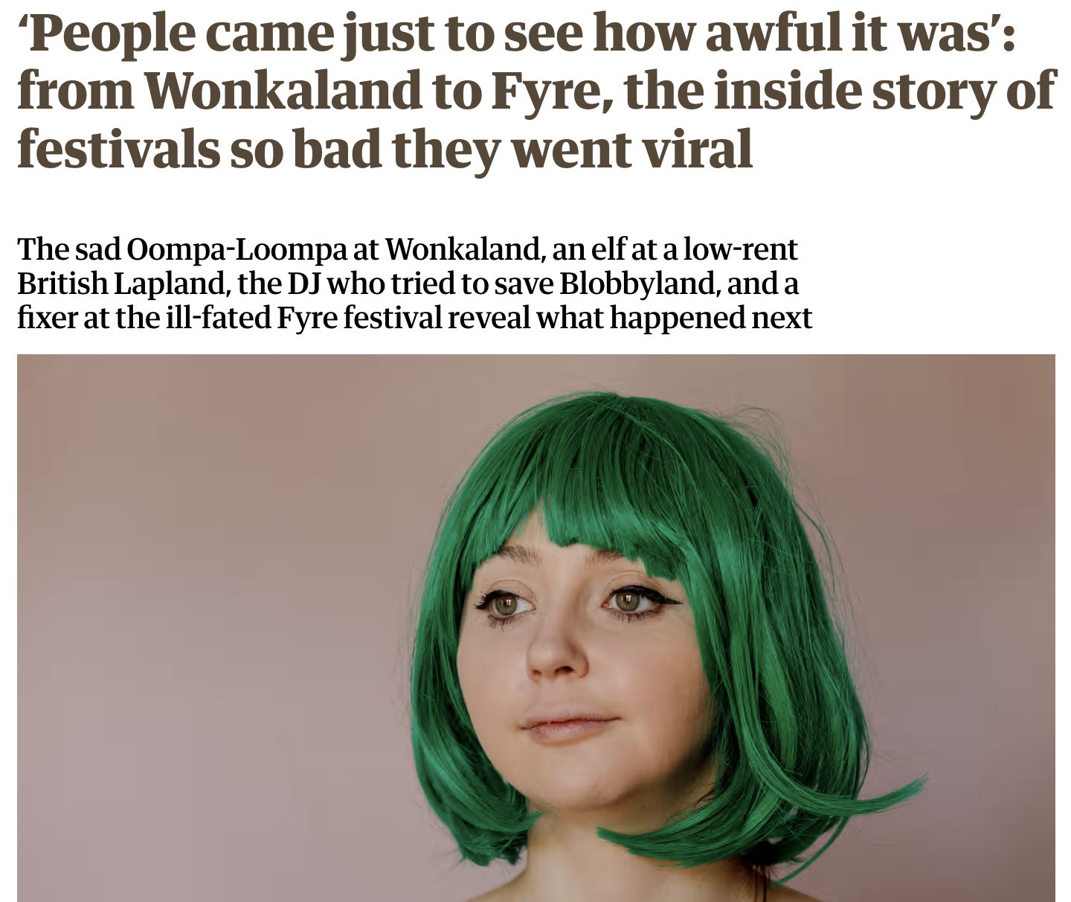
https://www.theguardian.com/culture/article/2024/aug/17/people-came-just-to-see-how-awful-it-was-from-wonkaland-to-fyre-the-inside-story-of-festivals-so-bad-they-went-viral

Slide 32
“I couldn’t have done it without researcher Kitty Drake, who is much younger than I am and therefore better at navigating strange online worlds like Reddit. Kitty tracked down Kirsty, Wonkaland’s sad Oompa-Loompa in no time. She then found Emma, who once got a job at the fiasco that was Lapland New Forest and who is still occasionally referred to as “the slapped elf”.
“Blobbyland, weirdly, was harder. I knew about the short-lived 1990s theme park from my colleague Helen Pidd who is from Morecambe, and has written about it, but finding someone who had worked there wasn’t easy. A Morecambe group on Facebook accepted my request to join. I posted: did you work at Blobbyland and would you talk to the Guardian about it?” (Saturday Edition Newsletter)

Slide 33
Where to find representatives
Unions (search ‘union’ and your area)
Industry bodies + networks (e.g. Chambers of Commerce)
Charities (search ‘charity’ and keywords)
Facebook group owners
Group owners/founders
Religious leaders

Slide 34
Where to find powerful people
Elected officials (local/national government)
Decision makers (regulators)
Police forces - look for specialist teams/roles
Employers (who has power to hire and fire)
Any ‘big name’ in the field whose words matter

Slide 35
Any problems with this approach?

Slide 36
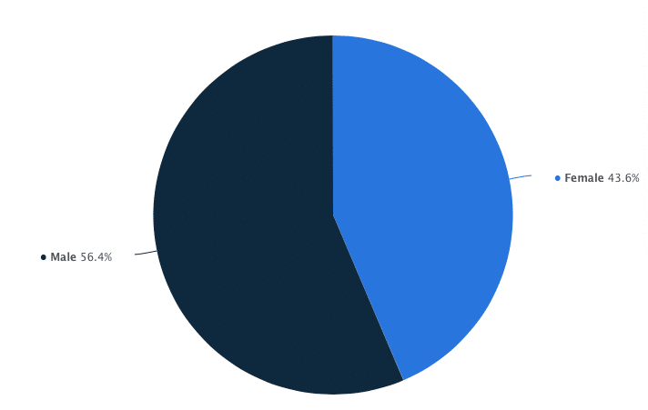
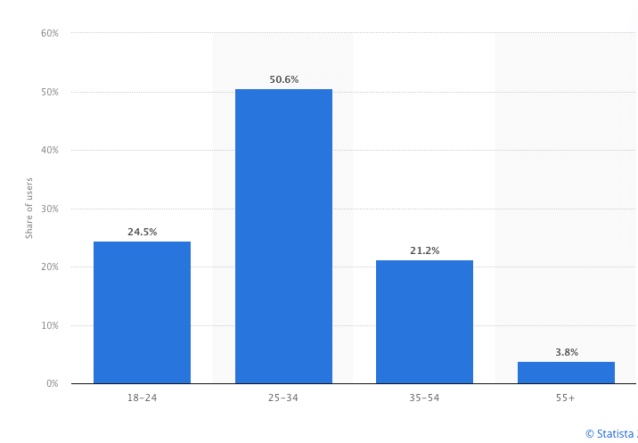
https://expandi.io/blog/linkedin-demographics/

Slide 37
Two-thirds of news influencers are men — and most have never worked for a news organization
A new Pew Research Center report also found nearly 40% of U.S. adults under 30 regularly get news from news influencers.
https://www.niemanlab.org/2024/11/two-thirds-of-news-influencers-are-men-and-most-have-never-worked-for-a-news-organization

Slide 38
Ah.

Slide 39
How universities can address the lack of Black scholars in academia
In the UK, out of 164 university vice-chancellors, only two are Black. Professor David Mba was recently appointed as the first Black vice-chancellor at Birmingham City University.
There are 165 Black professors in the UK – out of 23,515. The disparity becomes even more alarming when examining the representation of Black female professors. Only 61 UK professors are Black women.
In the three academic years from 2016-17 to 2018-19, UK research councils granted 19,868 funded PhD studentships – but only 245 were allocated to students of Black and mixed-Black heritage.
Ifedapo Francis Awolowo, 2023

Slide 40
Mm.

Slide 41
There are almost 14 million disabled people living in the UK, with 19% of working age adults classed as disabled.* If we want our Service to be representative of the communities we serve, we should be attracting and retaining skilled workers who are disabled. This seems simple, but it’s not happening.
Figures from 2014 show that just 1.9% of police officers had declared a disability.** Our own current statistics confirm this huge underrepresentation. Of 1285 Superintendents and Chief Superintendents in our Association, only 18 stated they have a disability (1.4%).
Police Superintendents Association President Paul Griffiths

Slide 42
Uh-huh.

Slide 43
Do charities have a class problem?
by Joe Lepper
According to charity leadership body Association of Chief Executives of Voluntary Organisations (ACEVO), more than a sixth of British charity bosses have been privately educated.
Its 2022 Pay and Equalities Survey gathered responses from just under 900 charity leaders and found that 17.5% had attended an independent or fee-paying school for most of their education between the ages of 11 and 16, although this also includes a minority who were entitled to a means test bursary.
This high prevalence of privately education charity leaders compares to around 7% of the wider UK population who went to such elite fee-paying schools.
https://charitydigital.org.uk/topics/do-charities-have-a-class-problem-10575

Slide 44
Err...

Slide 45
How do we ensure diverse sourcing?
Diverse experts directories
Go through representative bodies (e.g. Disabled Police Association, SBA) and initiatives/events
LinkedIn may provide details on education & membership
Ask people who have written about lack of diversity
Free ebook: Everybody In

Slide 46
The approach

Slide 47
How to get sources to talk to you
Be professional
Be interested (show you’ve done your research)
Be interesting (have some new info)
Don’t talk about your obligations (“I have to do”)
Motivate them (what will it achieve?)
Pick a source who talks (it’s their job)

Slide 48
Empathy: why should they help?
Identify & address reasons they may not want to cooperate
Time? Be succinct
Convenience? Make it convenient and specific - be flexible
Wariness? Establish trust (go through a go-between)
Don’t call it an “interview”. Have a chat first
Consider and mention benefits to cooperation

Slide 49
Consider mode of approach
Email vs direct message vs phone vs in person
Easy to you also means easy to ignore
More personal modes are more likely to be successful
If you’re redirected to email, chase up the email on the phone
Ask to interview in the morning (less tasks to pile up)

Slide 50
Do it now:
In a group, identify reasons for not cooperating for:
A graffiti artist
An art gallery owner
A business owner
A councillor
A police officer

Slide 51
Subject: Interview
Dear Ms X,
I’m working on a [insert story type] about the challenges new artists face breaking into the music industry. I thought your research on X made some really important points and I’d like to include those in the story.
Would you be available to talk to me at some point next week?
Yours sincerely, Paul Bradshaw [add extra details]

Slide 52
Bonus tip: Ask genAI to help you write emails:
Prompt: You are a [DESCRIBE YOUR ROLE] looking to interview an [DESCRIBE THE TYPE OF INTERVIEWEE] for a story on [INSERT SUBJECT].
Write a succinct professional email asking them if they would agree to be interviewed by you for your story, considering reasons that they might want to participate.
[ADD ANY BACKGROUND INFORMATION THAT CAN BE USED, SUCH AS DETAILS OF THEIR RESEARCH, EXPERIENCE, ETC]

Slide 53
Build failure into your planning:
Assume that most people won’t talk to you, or will pull out
It’s not personal, or a mistake — plan for it
Identify enough potential interviewees to account for refusals and ghosting: >10 for every one you need

Slide 54
Key points
Use both human and documentary sources to research your story
Use checklists to brainstorm different types of interviewees
Use a range of sources to find interviewees
Consider who is over-represented in your results — and take steps to avoid reproducing that

Slide 55
Directed reading/watching (1-2 hours)
DJ: Watch: Research for the Newsroom playlist
MP: Read: Rothwell, J. Interview strategies in De Jong et al (2012) Creative Documentary: Theory and Practice (in Moodle folder on resources on interviewing
Optional listen: How to Book Engaging Podcast Interviews
Optional read: Blaine: The Digital Reporter’s Notebook
Optional watch: guest talk by Niamh McIntyre

Slide 56
Directed study (1-2 hours)
Use a range of sources to identify potential interviewees for your story idea across all 4 categories. 20+ names total, at least an hour!
Identify any over-represented demographics and ways you might address that - to discuss next week
Make a shortlist of your top 5 - why are they top?
Be ready to discuss next week!

Slide 57
Date for your diary: Nov 1
The next tech session, on audio recording, will take place on Nov 1 after our class (12-2) in C265

Slide 58


Slide 59
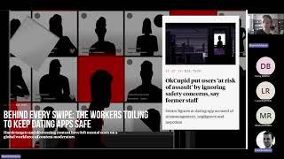
Optional video: Niamh McIntyre on sourcing https://www.youtube.com/watch?v=qlF_2ehfCcg

